Slide 1
The Global Environment
Park, Seon Ki Prof.
Irreversible climate change
due to carbon dioxide emissions
GE13-A
0806079 Han, su yoen
0906073 Jung, so young
1006024 Baek, seo hee

Slide 2
CONTENTS
01 . Introduction
02 . Irreversible Climate Change
03 . Conclusion
04 . Reference

Slide 3
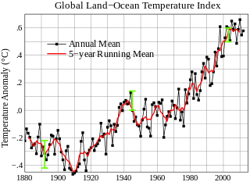
Introduction
Arctic sea ice retreat, increases in heavy rainfall and flooding, permafrost melt, loss of glaciers and snowpack, increased intensity of hurricanes, etc

Slide 4
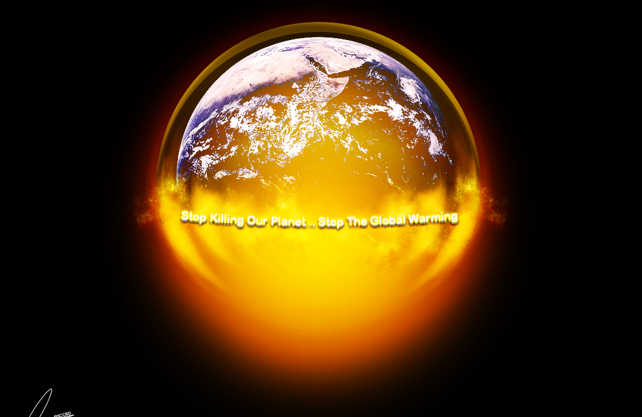
Introduction
CO₂
H₂O
CH₄
O₃

Slide 5
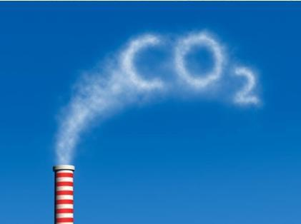
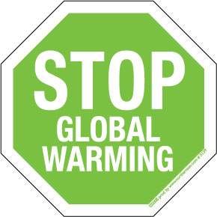
Introduction
X
Climate change that takes place due to increases in carbon dioxide concentration is largely
irreversible for 1,000 years after emissions stop.

Slide 6
Introduction
Climate change depends
not only on the magnitude of the change
but also on the potential for irreversibility.

Slide 7
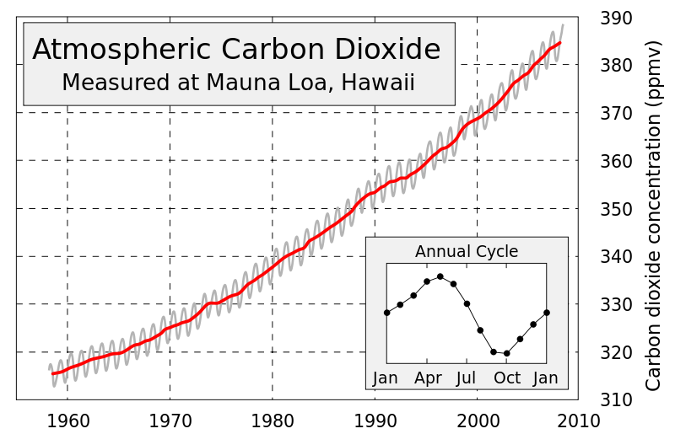
Introduction
450-600
(ppmv)
Irreversible
dry-season rainfall reductions
in several regions
&
Inexorable
sea level rise

Slide 8
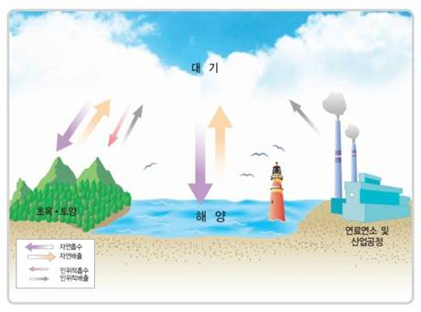
Longevity of an Atmospheric CO2 perturbation

Slide 9
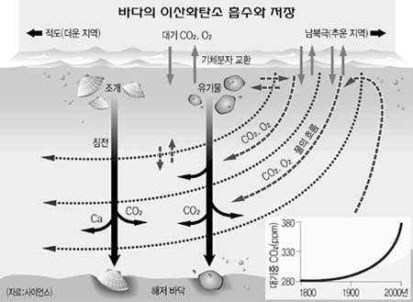
Longevity of an Atmospheric CO2 perturbation
Plankton population↓
Dissolved CO2
levels↓
Temp ↑
Solubility↓

Slide 10
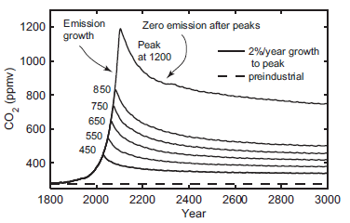
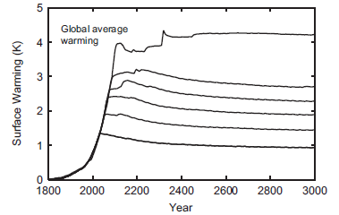
Longevity of an Atmospheric CO2 perturbation
The atmospheric temperature increases caused by rising carbon dioxide concentrations are not expected to decrease significantly even if carbon emissions were to completely cease.

Slide 11
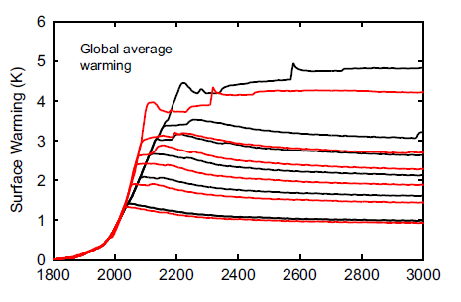
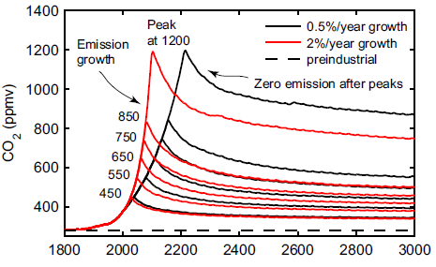
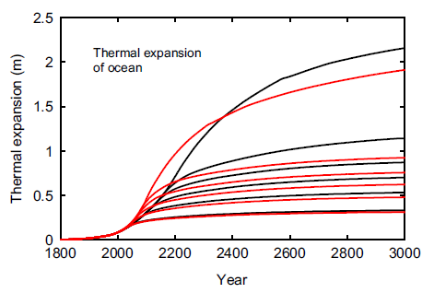
Longevity of an Atmospheric CO2 perturbation

Slide 12
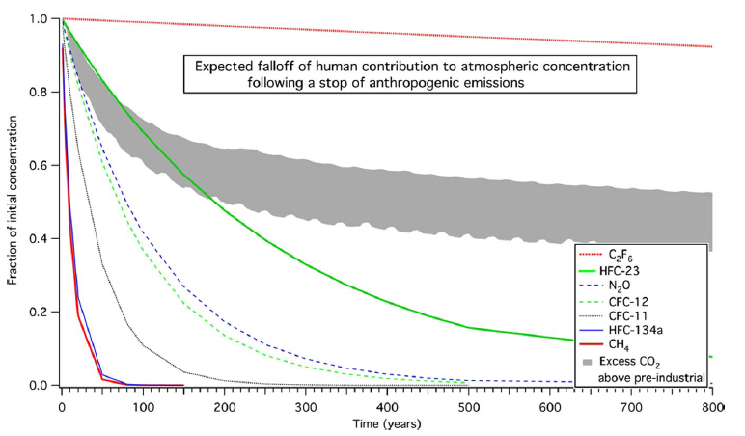
Longevity of an Atmospheric CO₂ perturbation

Slide 13
Irreversible
Climate Change
▶ Atmospheric Warming
▶ Precipitation Changes
▶ Sea Level Rise

Slide 14
Atmospheric Warming

Slide 15
Irreversible Climate Change
Atmospheric Warming
Global average temperatures increase while CO₂ is increasing and then remain approximately constant until the end of the millennium despite zero further emissions.

Slide 16
Irreversible Climate Change
Atmospheric Warming
the ratio of actual and equilibrium temperatures
the ratio of actual warming to the equilibrium temperature for the peak CO₂ concentration

Slide 17
Precipitation Changes

Slide 18
Irreversible Climate Change
Precipitation Changes
By The Clausius–Clapeyron law
Global temperature
Atmospheric water vapor concentrations
Changes in water vapor transport
The hydrologic cycle can hence be expected
Precipitation changes

Slide 19
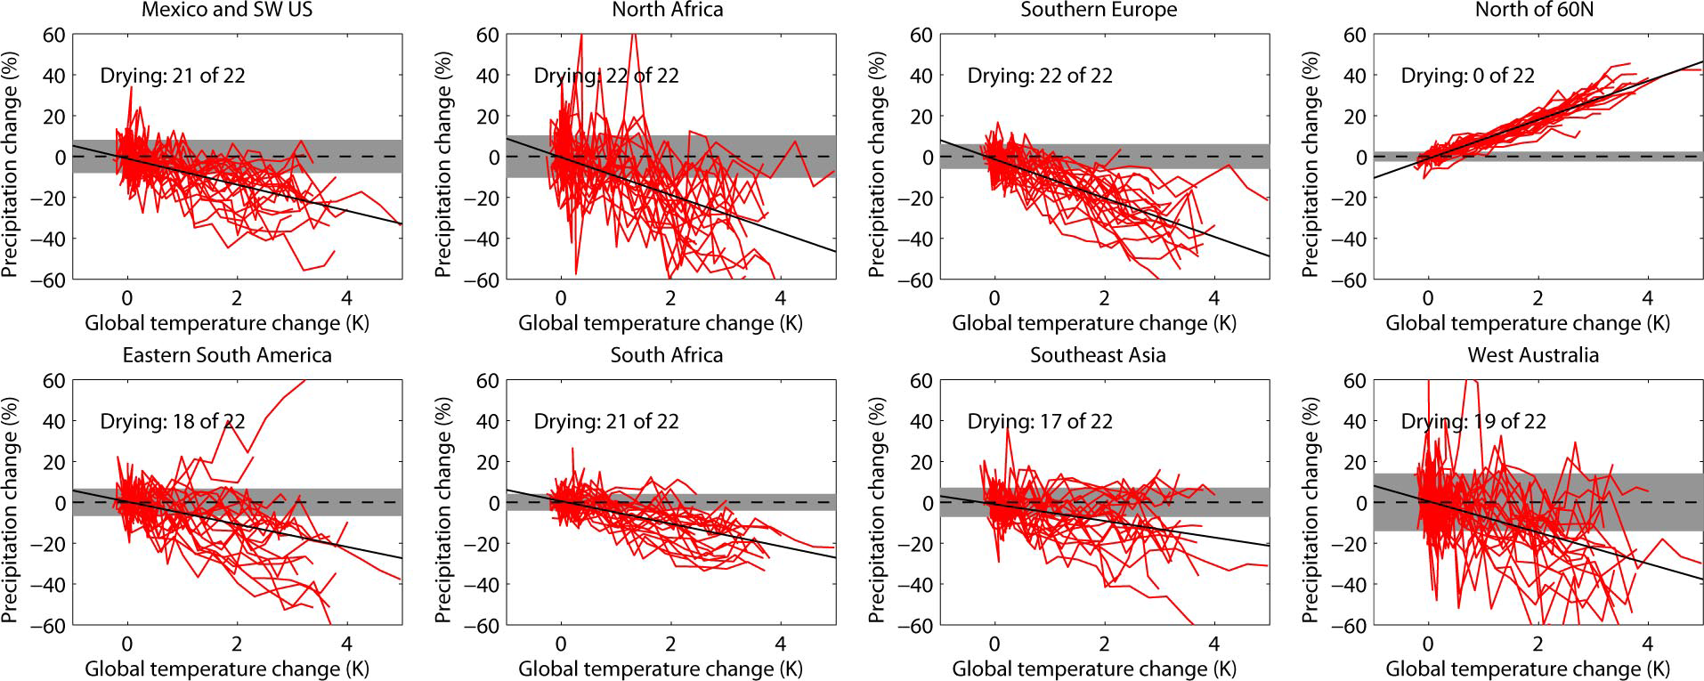
Irreversible Climate Change
Precipitation Changes

Slide 20
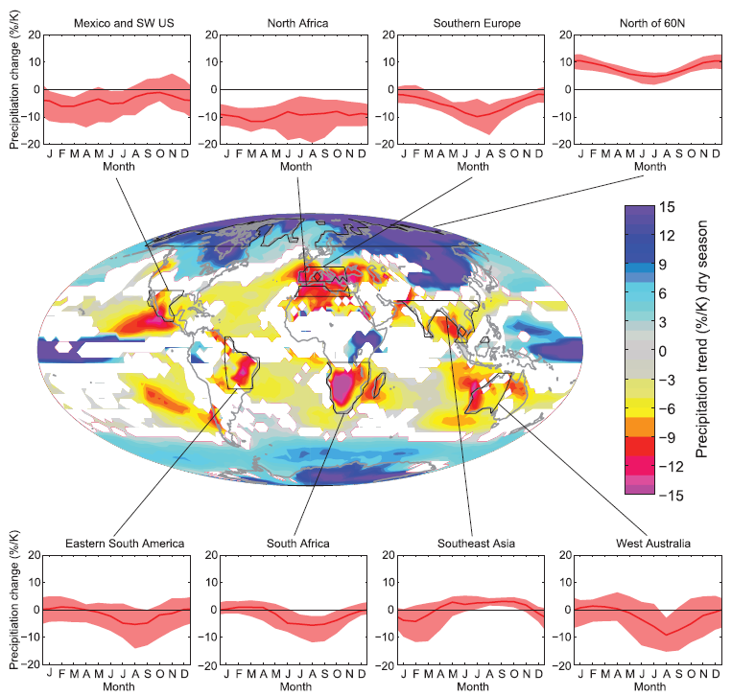
Irreversible Climate Change
Precipitation Changes

Slide 21
Irreversible Climate Change
Precipitation Changes
(parts per million by volume)

Slide 22
Sea Level Rise

Slide 23
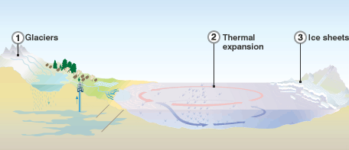
Irreversible Climate Change
Sea Level Rise
Primary causes of Sea Level Rise
Glaciers: If the world's mountain glaciers and icecaps melt, sea levels will rise by an estimated 0.2~0.7m
Ice sheets: These vast reserves contain billions of tonnes of frozen water - if the largest of them (the East Antarctic ice sheet) melts, the global sea level will rise by an estimated 64m
The two major causes of glabal sea level rise are thermal expansion of the oceans and the loss of land-based ice due to increased melting.

Slide 24
Irreversible Climate Change
Sea Level Rise
Primary causes of Sea Level Rise
Thermal expansion: The expansion of warming oceans was the main factor contributing to sea level rise, in the 20th Century, and currently accounts for more than half of the observed rise in sea levels

Slide 25
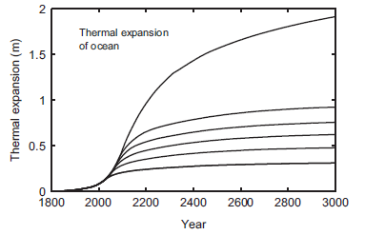
Irreversible Climate Change
Sea Level Rise
Ice albedo effect: warming tends to decrease ice cover and hence the albedo, increasing the amount of solar energy absorbed, leading to more warming.
the amount of ice ↓
Temp ↑
albedo ↓
energy absorbed ↑

Slide 26
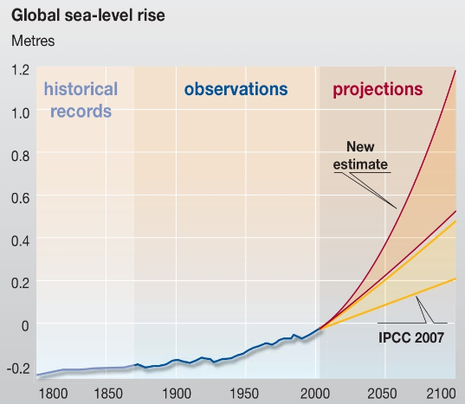
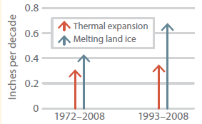
Irreversible Climate Change
Sea Level Rise
?
The updated estimates of the future global mean sea level rise
are about double the IPCC projections from 2007.

Slide 27
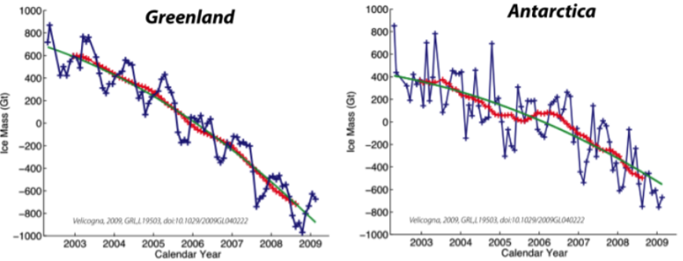
Irreversible Climate Change
Sea Level Rise
The Greenland and The Antarctic Ice Sheet has many meters of potential sea-level rise to contribute in the future.

Slide 28
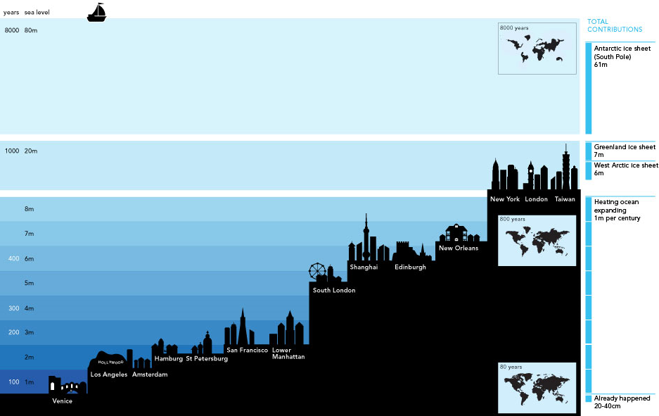
Irreversible Climate Change
Sea Level Rise

Slide 29
CONCLUSION
Irreversible climate changes due to carbon dioxide emissions have already taken place, and future carbon dioxide emissions would imply further irreversible effects on the earth.
But, irreversible does not mean unavoidable.
Although emissions reductions cannot return global temperatures to preindustrial levels, they do have the power to avert additional warming on the same time scale as the emissions reductions themselves.

Slide 30
REFERNCES
http://www.climate.org/topics/sea-level/
「Irreversible Does Not Mean Unavoidable」, Science 2013 340 (6131) 438-439
「Projections of future sea level becoming more dire」, Proc. Natl. Acad. Sci. USA 2009 106 (51) 21461-21462
「Future CO2 Emissions and Climate Change from Existing Energy Infrastructure」, Science 2010 329 (5997) 1330-1333
「Time-dependent climate sensitivity and the legacy of anthropogenic greenhouse gas emissions」, Proc. Natl. Acad. Sci. USA 2013 110 (34) 13739-13744
http://happykorea.ca/print_paper.php?number=12297
http://blog.naver.com/PostView.nhn?blogId=energyplanet&logNo=10094175216
http://ko.wikipedia.org/wiki/
www.sciencedaily.com/releases/2007/11/071119112231.htm

Slide 31
THANK YOU

