Slide 1
The Global Environment
Park, Seon Ki Prof.
Feedback:
Water vapor, Cloud and Lapse Rate
GE13-A
0806079 Han, su yoen
0906073 Jung, so young
1006024 Baek, seo hee

Slide 2
CONTENTS
01 . Introduction
02 . Climate Change Feedback
Water Vapor Feedback
Lapse Rate Feedback
Cloud Feedback
03 . Discussion
04 . Reference

Slide 3
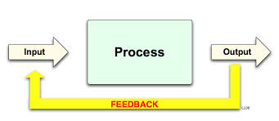
Introduction
Feedback
a process in which information about the past or the present influences the same phenomenon in the present or future. As part of a chain of cause-and-effect that forms a circuit or loop.

Slide 4
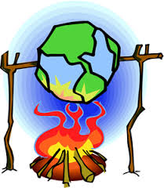
Introduction
Climate Change ???
Significant and lasting change
in the statistical properties
of the climate system
when considered over long periods of time, from decades to millions of years.

Slide 5

Introduction
Water Vapor
Sea-Ice
Cloud
Lapse Rate
Biogeochemistry & Carbon Cycle
Ocean Heat and Circulation
Atmospheric Chemistry

Slide 6

Climate Change
Feedback
Wate Vapor Feedback
Lapse Rate Feedback
Cloud Feedback

Slide 7
Water Vapor Feedback

Slide 8
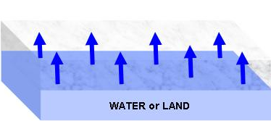

Feedback
Water Vapor Feedback
What is water vapor?
water in its gaseous state-instead of liquid or solid (ice)
invisible
greenhouse gas ( accounting for about 90% of the Earth's natural greenhouse effect, which helps keep the Earth warm enough to support life )
Water vapor is extremely important to the weather and climate. Without it, there would be no clouds or rain or snow, since all of these require water vapor in order to form. All of the water vapor that evaporates from the surface of the Earth eventually returns as precipitation - rain or snow.

Slide 9
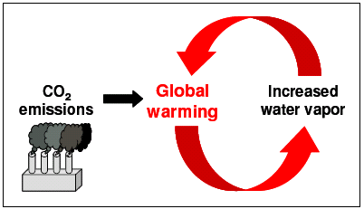
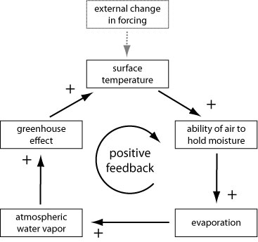
Feedback
Water Vapor Feedback
Water vapor feedback

Slide 10
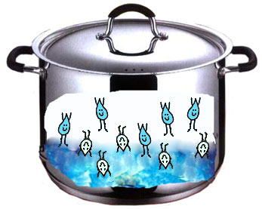

Feedback
Water Vapor Feedback
water vapor feedback
Temperature
Humidity
Kinetic Energy
Condensation
Speed

Slide 11
Lapse Rate Feedback

Slide 12
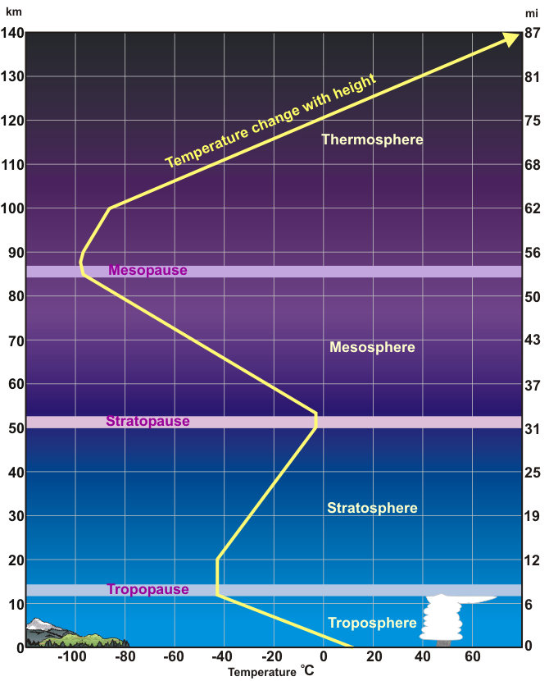
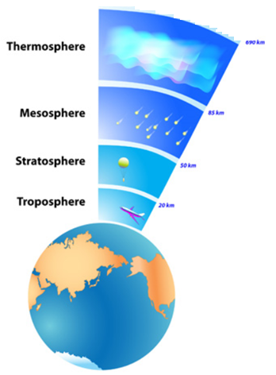
Feedback
Lapse Rate Feedback

Slide 13



Feedback
Lapse Rate Feedback
tropopause
contains 80% of the mass of the atmosphere
heated by transfer of energy from surface
Temperature decreasing
What is a lapse rate?
Height
increasing
the rate of temperature decreases with altitude
the rate of 6.5℃/km
affects on the greenhouse effect
surface

Slide 14
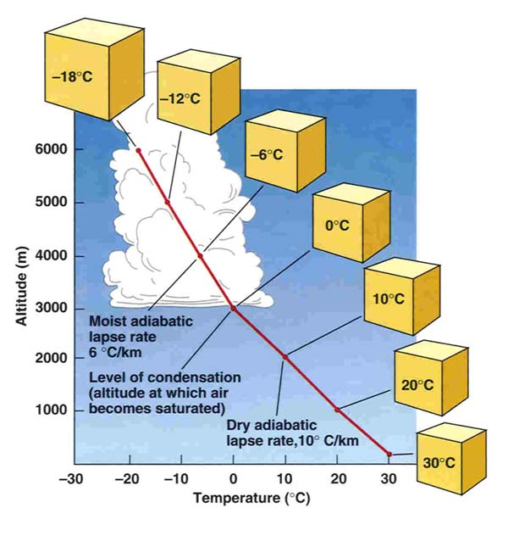
Feedback
Lapse Rate Feedback
Lapse Rate
Environmental lapse rate
Height: Lapse rates depend on ground temperature
(and are normally less near the ground)
Time of Year: Lapse rates are lower in winter or during
a rainy season.
Surface: Lapse rates are lower over land than sea.
Air masses: Different properties of air masses mean
different lapse rates.
The adiabatic lapse rate
Dry adiabatic lapse rate(DALR)
Saturated adiabatic lapse rate(SALR)

Slide 15
Feedback
Lapse Rate Feedback
A transfer of energy as work without transfer of heat between a system and its surroundings.
Adiabatic process
1st Law of Thermodynamics
Temperature
Change
Energy
Flow In/Out
Change in
Pressure
If no energy exchange with surroundings,
Temperature Change ~ Pressure Change
~ Change in Internal energy of volume
due to expansion or compression

Slide 16
Feedback
Lapse Rate Feedback
tropopause
10 ℃
Expands
and
cools
20 ℃
Compresses
and
warms
30 ℃
surface
when the air expands, the molecules must now cover a larger volume. This means that the air in the parcel must perform work to inhabit the increased volume. The work done by the parcel will result in lower kinetic energy, and the temperature must fall.

Slide 17


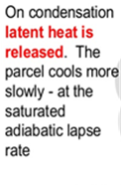
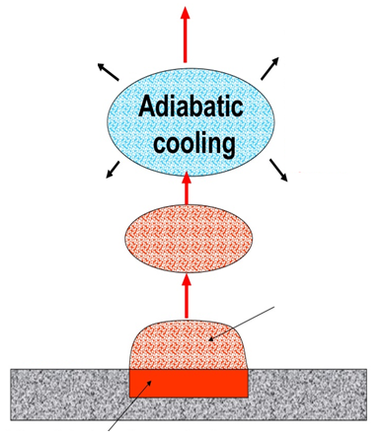

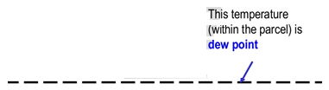



Feedback
Lapse Rate Feedback
Dry adiabatic lapse rate(DALR)
Saturated adiabatic lapse rate(SALR)

Slide 18
Feedback
Lapse Rate Feedback
Dry adiabatic lapse rate(DALR)
Saturated adiabatic lapse rate(SALR)
10℃/km
6℃/km
If air has more water vapor(saturated), the lapse rate will be decreasing.
The smaller the lase rate becomes, the slower the temperature changes.

Slide 19
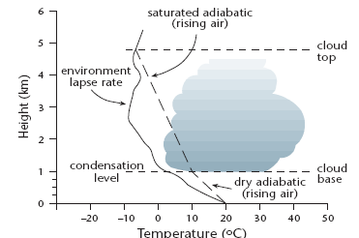
Feedback
Lapse Rate Feedback
The differences between lapse rates in the atmosphere
different weather to occur and different clouds form.
Atmospheric Stability & Instability
The relationship between the temperature and density of the air parcel and the surrounding air.
This can be thought of as the relationship between the ELR & DALR/SALR of the air parcel.

Slide 20
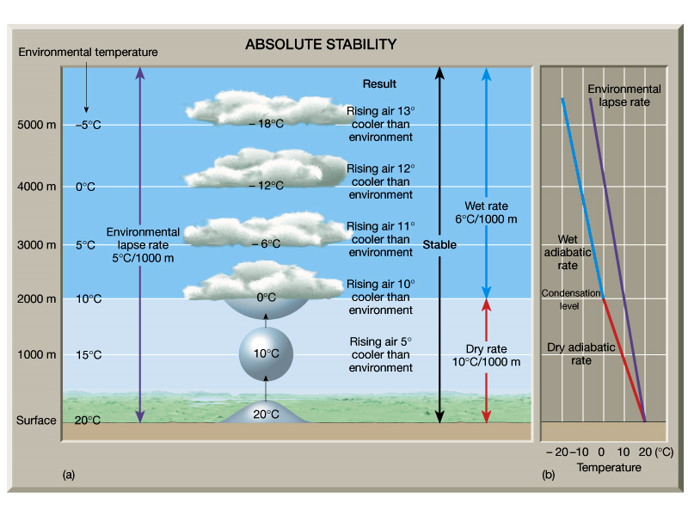
Feedback
Lapse Rate Feedback
Absolute stability
ELR < ALR(DALR/SALR)

Slide 21
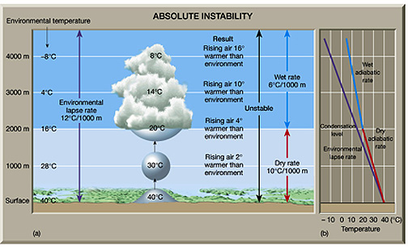
Feedback
Lapse Rate Feedback
Absolute Instability
ELR > ALR(DALR/SALR)

Slide 22
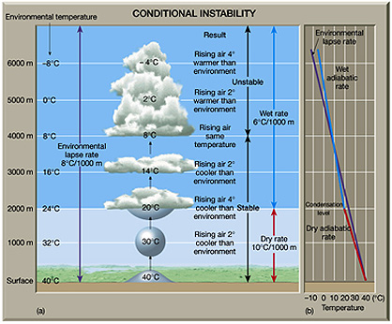
Feedback
Lapse Rate Feedback
Conditional Instability
SALR < ELR < DALR

Slide 23
Feedback
Lapse Rate Feedback
Definition of lapse rate feedback
The vertical variations of the temperature change.
When the earth gets warmer, air can contain more water vapor.
This has impact on the lapse rate.
(more water vapor = more heat transfer to higher altitudes)

Slide 24
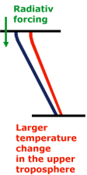
Feedback
Lapse Rate Feedback
Lapse rate feedback on tropics - Negative feedback
Surface temp ↑
X
Emission of IR↑
(latent heat)
-
Evaporation ↑
Lapse rate ↓
Water vapor amount ↑

Slide 25
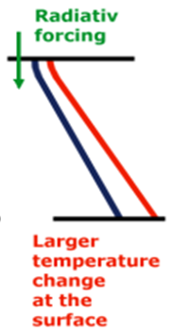
Feedback
Cloud Feedback
Lapse rate feedback on poles - Positive feedback
Surface temp ↑
+
Evaporation ↑
Emission of IR↓
Stable stratification
Lapse rate ↑
Surface warming ↑

Slide 26
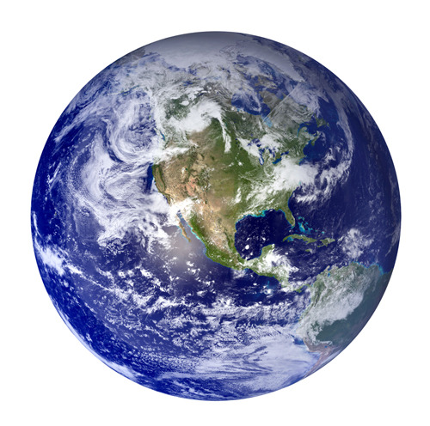
Feedback
Lapse Rate Feedback
Positive Lapse Rate Feedback
Tropics of cancer 23.5 °N
Equator
Negative Lapse Rate Feedback
Tropics of capricorn 23.5 °S
Positive Lapse Rate Feedback
Negative Lapse Rate Feedback

Slide 27
Feedback
Lapse Rate Feedback
Summary of lapse rate feedback
Lapse rate: the rate of temperature decreasing with altitude
Dry Adiabatic Lapse rate > Saturated Adiabatic Lapse rate
If the lase rate is decreasing, the temperature change will be slower
Stability: ELR < ALR
Instability: ELR > DALR, SALR
Conditional instability: SALR < ELR < DALR
Negative Lapse Rate Feedback: Tropics
Positive Lapse Rate Feedback : Poles
Negative Lapse Rate Feedback

Slide 28
Cloud Feedback

Slide 29
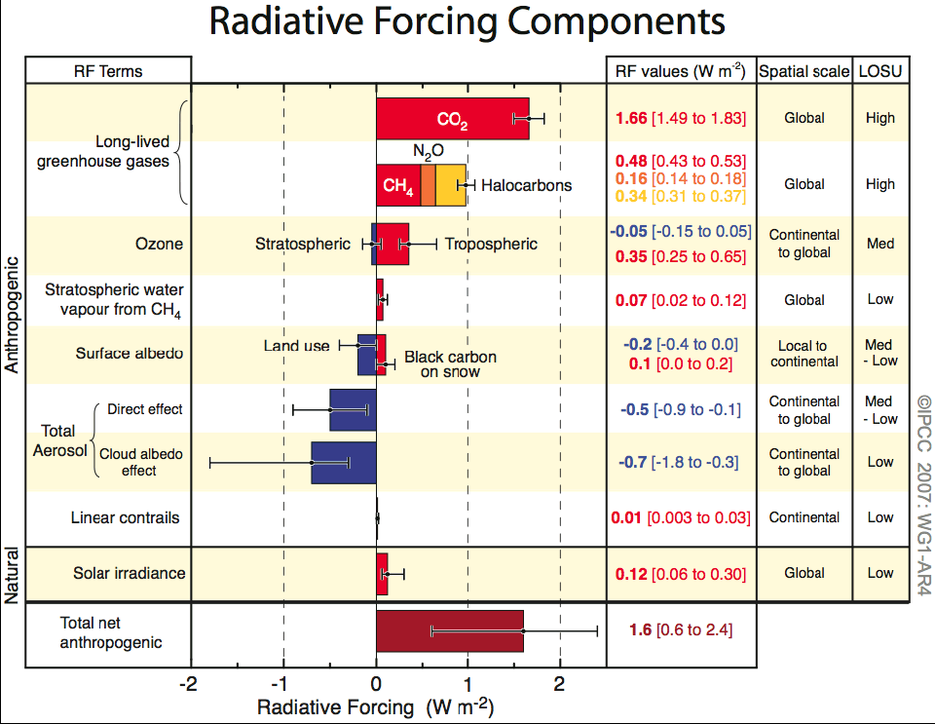
Feedback
Cloud Feedback
Albedo
the amount of radiation reflected by a surface.

Slide 30


Feedback
Cloud Feedback
The ROLE of CLOUDs
on Earth's Climate
Clouds : visible masses of liquid droplets and/or frozen crystals
Molecule by molecule, water in a solid or liquid phase is 1000 times more thermally absorbent than water vapor
one of the key reasons
clouds are such an important component of Earth’s climate.

Slide 31

Feedback
Cloud Feedback
The ROLE of CLOUDs
on Earth's Climate
SPACE
ATMOSPHERE
SURFACE

Slide 32
Feedback
Cloud Feedback
Definition of cloud feedback
Cloud feedback is the coupling between cloudiness and surface air temperature.
A change in radiative forcing perturbs the surface air temperature.
It leads to a change in clouds.
Then it could amplify or diminish the initial temperature perturbation.

Slide 33
Feedback
Cloud Feedback
Cloud feedback on terrestrial radiation - Positive feedback
External
Forcing
Surface temp ↑
Evaporation ↑
Water vapor amount ↑
Cloudiness ↑
LW absorption↑
(greenhouse effect)
+

Slide 34
Feedback
Cloud Feedback
Cloud feedback on solar radiation - Negative feedback
External
Forcing
Surface temp ↑
Evaporation ↑
Water vapor amount ↑
Cloudiness ↑
Albedo↑
X
-

Slide 35
Feedback
Cloud Feedback
Positive feedback & Negative feedback
Surface temp ↑
Evaporation ↑
Water vapor amount ↑
Cloudiness ↑
LW absorption↑
(greenhouse effect)
Surface temp ↑
Evaporation ↑
Water vapor amount ↑
Cloudiness ↑
Albedo↑
X
+
-

Slide 36
Feedback
Cloud Feedback
WHICH CLOUD TYPES MATTER FOR CLOUD FEEDBACK?
Cloud feedbacks are extremely variable between different climate models.
However, it is not always clear what is the relative contribution of cloud types from various regions to the global mean cloud feedback and its inter-model spread.
Scientists have developed novel techniques to separate the contribution of different cloud types and have found that cloud feedbacks are not the result of a single cloud type but that we must consider the feedbacks from many cloud types including low clouds, high clouds and mid-latitude clouds.

Slide 37
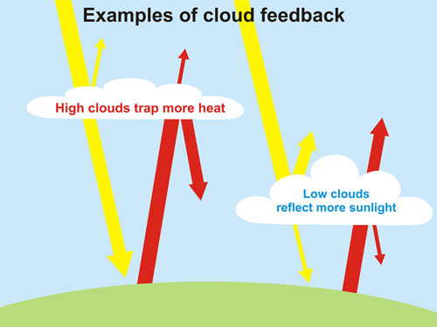
Feedback
Cloud Feedback
Low-level clouds tend to
cool by reflecting sunlight.
High-level clouds tend to
warm by trapping heat.

Slide 38
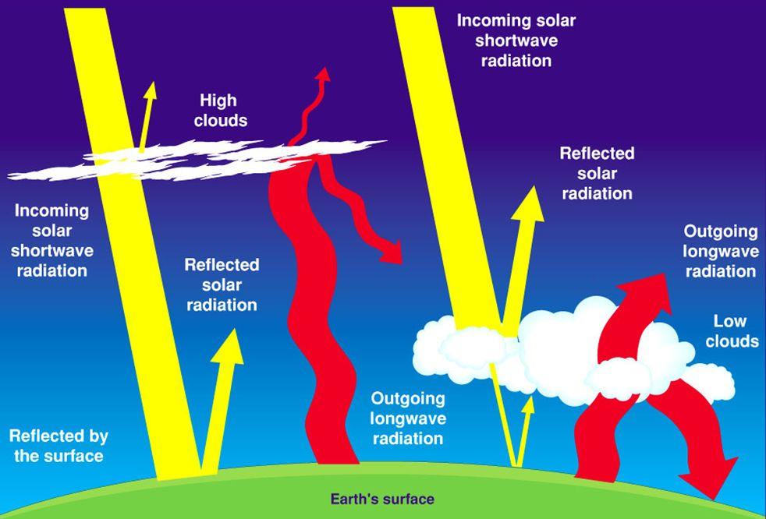
Feedback
Cloud Feedback

Slide 39
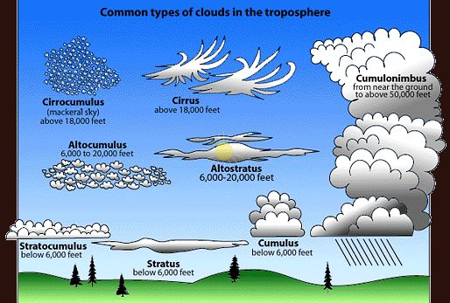
Feedback
Cloud Feedback

Slide 40
Feedback
Cloud Feedback
Low & Mid – level clouds

Slide 41

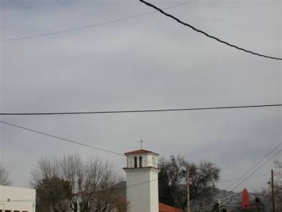
Feedback
Cloud Feedback
Low - level clouds
altostratus

Slide 42
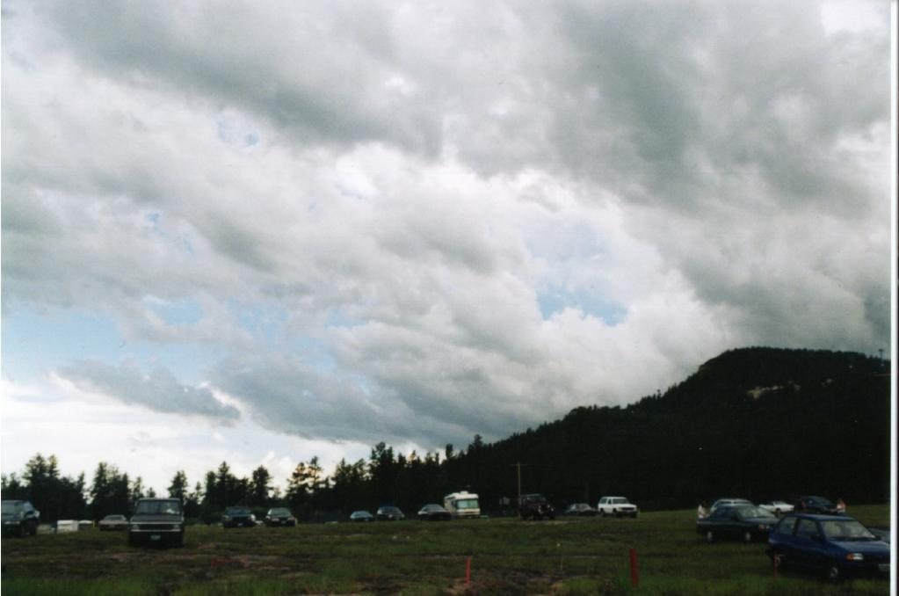
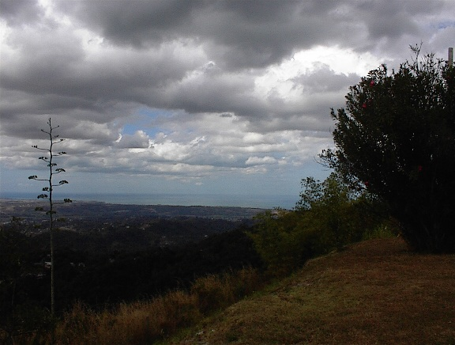
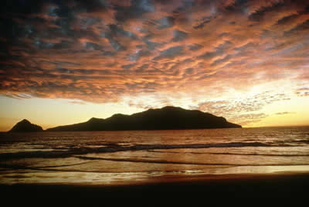
Feedback
Cloud Feedback
Low – level clouds
stratocumulus

Slide 43
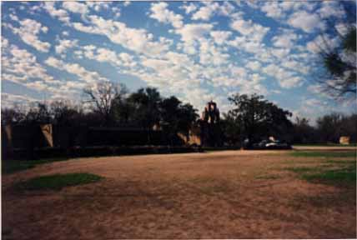
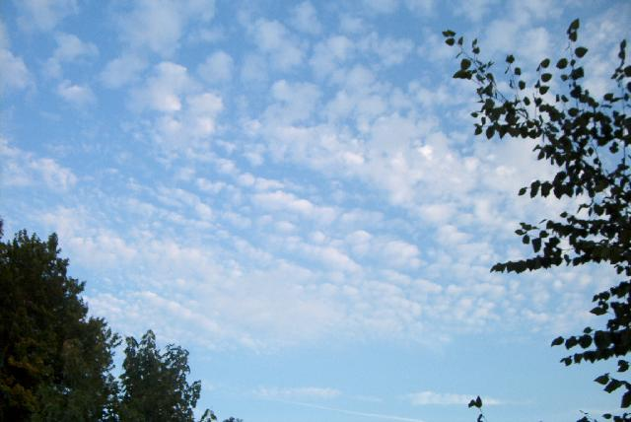
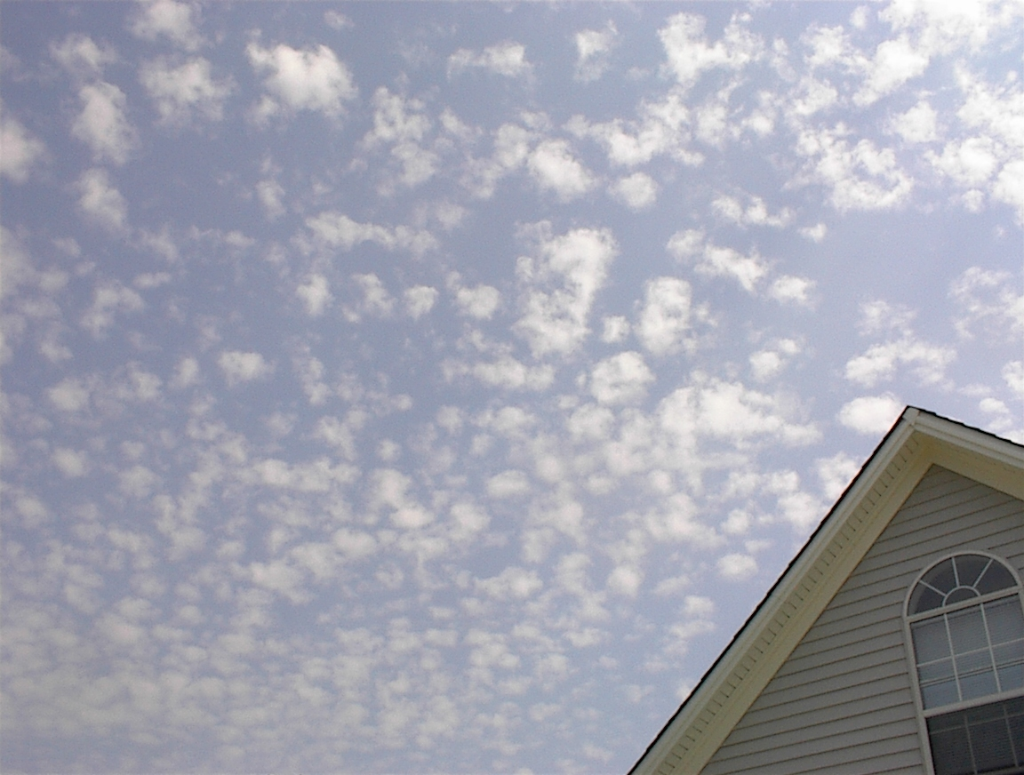
Feedback
Cloud Feedback
Mid – level clouds
altocumulus

Slide 44

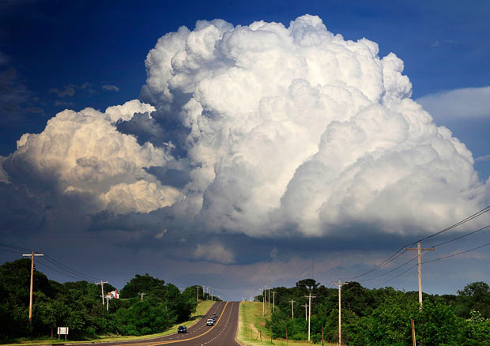
Feedback
Cloud Feedback
Low & Mid – level clouds
Fluffy clouds
Dense clouds
Aerosol particles
moisture
6km
surface

Slide 45
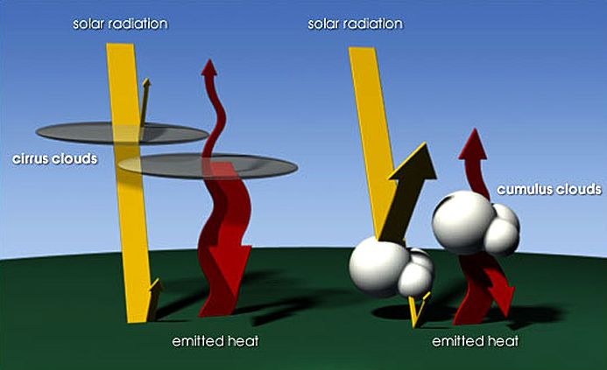
Feedback
Cloud Feedback
Low & mid – level clouds
Thickness & high density → high albedo
Seen from above, very white & reflect about 80% of the sunlight
Seen from below, grey or dark
– very little sunlight can penetrate
Contribute to the greenhouse effect
- trapping heat
But,
Greenhouse effect << reflecting sunlight
Cooling effect on the climate

Slide 46
Feedback
Cloud Feedback
Cumulonimbus cloud

Slide 47
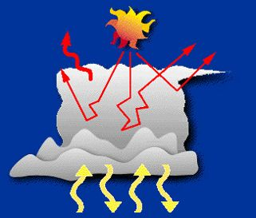
Feedback
Cloud Feedback
Cumulonimbus cloud
tops are high and cold → energy radiated to outer space is lower than it would be without the cloud
Very thick → reflect much of the solar energy back to space
greenhouse effect & albedo almost balance
overall effect of cumulonimbus clouds is neutral
-neither warming nor cooling

Slide 48
Feedback
Cloud Feedback
high – level clouds

Slide 49
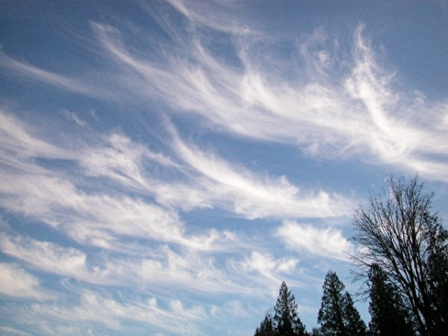

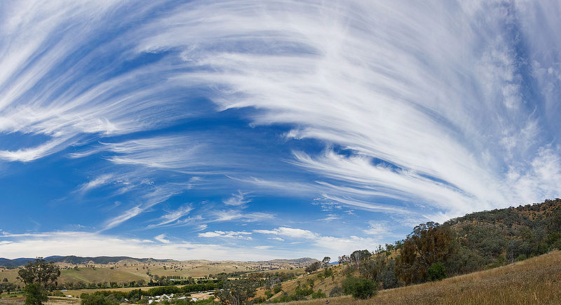
Feedback
Cloud Feedback
high – level clouds
cirrus

Slide 50

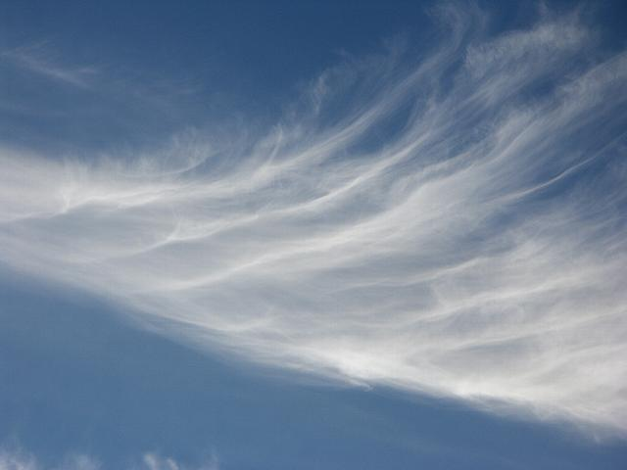
Feedback
Cloud Feedback
high – level clouds
cirrostratus

Slide 51
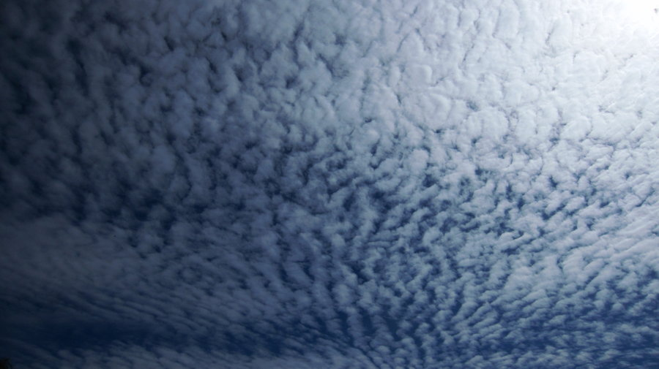


Feedback
Cloud Feedback
high – level clouds
cirrocumulus

Slide 52
Feedback
Cloud Feedback
high – level clouds
Sparse clouds
Wispy clouds
moisture
6km
surface

Slide 53
Feedback
Cloud Feedback
high – level clouds
low temperature → composed of ice crystals rather than water droplets
Sparse & thin → low albedo & reflect 10% of sunlight
only a slight cooling effect on the climate
Greenhouse effect >> reflecting sunlight
Warming effect on the climate

Slide 54
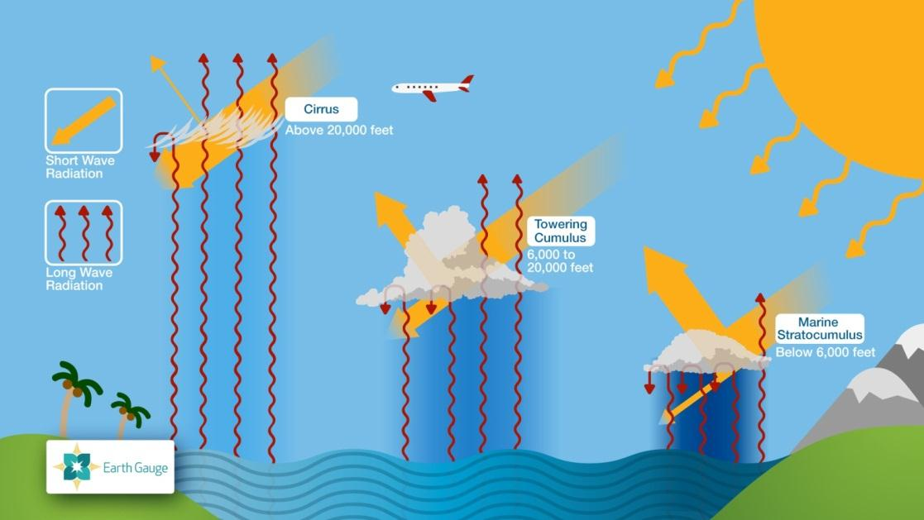
Feedback
Cloud Feedback
Reflect none of the incoming radiation
& absorb some of outgoing long wave
radiation
→ warming effect
Reflect as much energy as absorb
→ net neutral effect
Reflect lots of incoming sunlight
→ strong shading &
overall cooling effect

Slide 55
Feedback
Cloud Feedback
The temperature difference between the relatively warm surface below and cool cloud top above determines the magnitude of the LW effect
Larger differences → greater warming effect
small

Slide 56
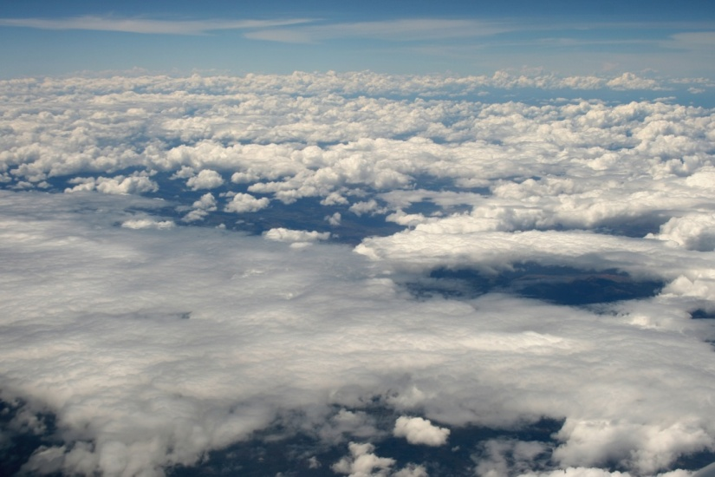
Feedback
Cloud Feedback
SMS(Subtropical marine stratocumulus) clouds
SMS clouds have a strong cooling effect.
Form in subtropical regions → warm troposphere + cool ocean surface water
& SMS clouds are made up of very small water droplets and are extremely
reflective
SMS clouds occur over only 2 to 6 % of the planet’s surface area
But,
they are important for maintaining Earth’s ocean circulation patterns
cloud tops of SMS clouds are normally only
slightly cooler than the surface waters below
Because the SMS clouds help to maintain cool conditions, they may influence global climate more than their absolute area of surface cover.
∴ LW warming effect << SW cooling effect

Slide 57
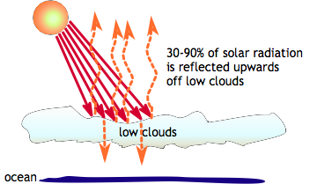
Feedback
Cloud Feedback
Low clouds reflect 30 to 90% of the incoming solar radiation.
cf. average albedo of the oceans (10%)
you can see that low clouds cause a dramatic reduction in the amount of energy reaching the Earth's surface.
∴ low clouds have a cooling effect on the Earth-Atmosphere system.

Slide 58
Feedback
Cloud Feedback
Scientists want to know more about these clouds
– why they form
– how they might change under global warming.
It is unclear right now if increased surface temperatures will result in more or less low clouds

Slide 59
Feedback
Cloud Feedback
uncertainty
Surface temp ↑
Cloudiness ↑
Albedo ↑
Surface temp ↑
Cloudiness ↓
Solar radiation reaches surface ↑
X
-
+
In order to find out the future effects of low clouds on our climate,
we need to know more about how these clouds respond to changes in temperature, humidity, and aerosol types and sizes.

Slide 60
Feedback
Cloud Feedback
While clouds remain a significant uncertainty,
the evidence → clouds will probably cause the planet
to warm even further and are very unlikely to cancel out
much of human-caused global warming.

Slide 61
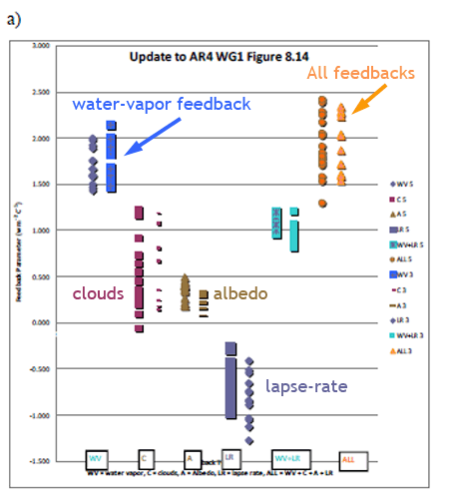
CONCLUSION
It's also important to remember that there many other feedbacks besides clouds.
There is a large amount of evidence that the net feedback is positive
and will amplify global warming.

Slide 62
REFERNCES
Understanding Climate Change Feedbacks, the national academies
기후는 이산화탄소 증가에 얼마나 민감한다, 최용상, Jour. Korean Earth Science Society, v. 32, no. 2,
p. 239−247, April 2011
구름 복사 강제력과 해수면온도의 관계, 이우섭, 김명기, 공주대학교 대기과학과, pp 394~ 395
위성에서 파생된 구름 인덱스를 사용한 복사량 측정 비교, 김효정, 조일성, 이규태, 2013년도
한국기상학회 봄학술대회 논문집, pp 558~ 559
지표 온난화에 미치는 구름-복사 피드백의 계절 의존도, 김맹기, 강인식, pp 196~197
http://www.cmmap.org/research/docs/jan08/tak.pdf
http://aviationknowledge.wikidot.com/aviation:mid-level-clouds
http://www.earthgauge.net/wp-content/CF_Cloud_Feedback.pdf
http://www.skepticalscience.com/clouds-negative-feedback.htm
http://www.sciencemuseum.org.uk/climatechanging/climatescienceinfozone/exploringearthsclimate
/1point4/1point4point1.aspx
http://www.astr.ucl.ac.be/textbook/chapter4_node8.html
http://earthobservatory.nasa.gov/Features/Iris/iris2.php
http://earthobservatory.nasa.gov/Features/Clouds/

Slide 63
THANK YOU:)

